Slide 1
Probability II
Jaeseok Cho
07/25/2020

Slide 2
Course plans and Objectives
- We will learn about:
Types of Data: Continuous vs Discrete
Distributions: What is this concept and potential application
Expected value
Variance and standard deviation
Statistics and Political Science

Slide 3
Types of Data
Continuous Variable:
Uncountable
Infinite
Examples: Temperature (Degree), heights, weights, and amount of trade

Slide 4
Continuous Variable
Example: Amount of Trade between Ireland and Britain(in pounds)

Slide 5
Types of Data
Discrete Variable:
Countable and finite
Examples: Age, Number of people, and number of car accidents

Slide 6
Discrete Variable
Number of people by their ages

Slide 7
Distribution
-What is the ‘percentage’ of people whose age is 51?
-From the graph from previous page, we know the distribution of ages.
-Using the distribution of data, we can infer the information

Slide 8
Distribution
-What does ‘distribution’ mean? Perhaps, we already know about the concept but vaguely. What is the true meaning of this concept?
-Let’s take a minute or two to think about what is the definition of this concept before proceed to the next slide

Slide 9
Distribution
-Distribution is “the set of values of a set of data, possibly grouped into classes, together with their frequencies or relative frequencies” (Upton and Cook, 2008, pp 110)
-Distribution is valuable because we can infer the “probability” that certain values will occur by looking at distribution of certain variables

Slide 10
Distribution
-More importantly, we are also interested in distribution of ‘random variables’
-Let’s proceed and learn about random variables

Slide 11
Random Variable
“when the value of a variable is subject to random variation, or when it is the value of a randomly chosen member of a population, it is described as a random variable” (Upton and Cook, 2008, pp 307)

Slide 12
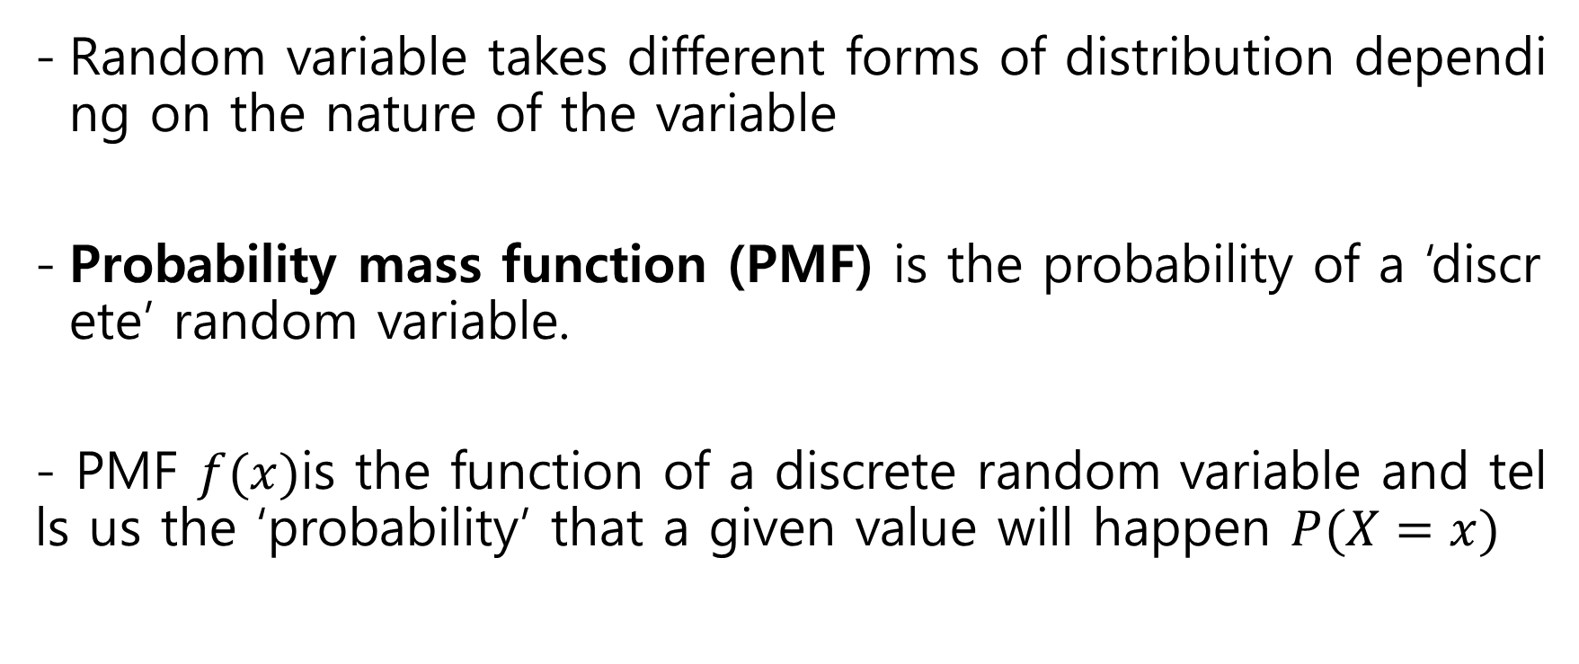
Random Variable
Random variable takes different forms of distribution depending on the nature of the variable
Probability mass function (PMF) is the probability of a ‘discrete’ random variable.
- PMF $f(x)$is the function of a discrete random variable and tells us the ‘probability’ that a given value will happen $P(X=x)$

Slide 13

Random Variable
Properties of PMF:
$0≤f(x)≤1$
$\sum{f(x)}=1$

Slide 14

Random Variable
Cumulative distribution function (CDF) tells us the ‘cumulative probability’ that a given value or values smaller than that will happen $P(X≤x)$,$−∞<x<∞)$.

Slide 15
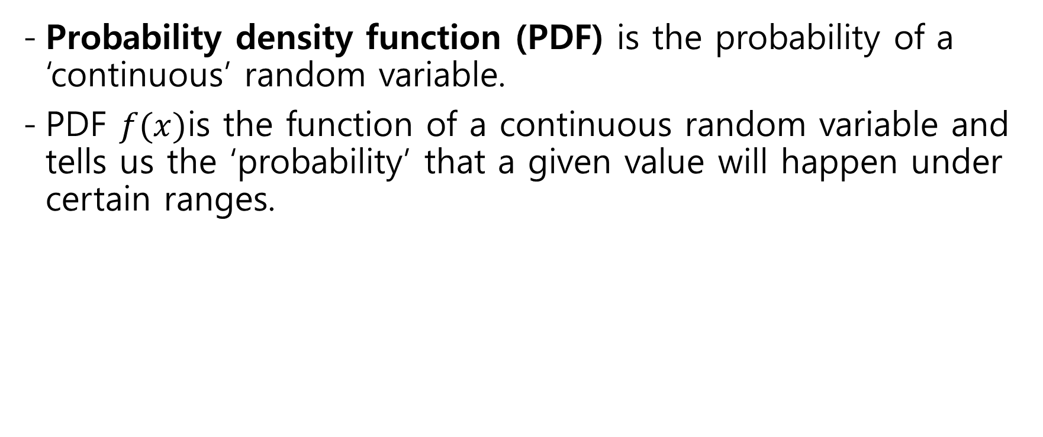
Random Variable
Probability density function (PDF) is the probability of a ‘continuous’ random variable.
PDF $f(x)$is the function of a continuous random variable and tells us the ‘probability’ that a given value will happen under certain ranges.

Slide 16

Random Variable
Properties of PDF:
$P\left(a≤X≤b\right)= \int_{a}^{b}{f\left(x\right)dx}$
$f(x)≥0$
$\int_{−∞}^{∞}{f\left(x\right)dx} =1$

Slide 17

Random Variable
Cumulative density function (CDF) is the probability of a ‘continuous’ random variable and tells us the ‘cumulative probability’ that a given value or values smaller than that will happen $P(X≤x)$,$−∞<x<∞)$.

Slide 18
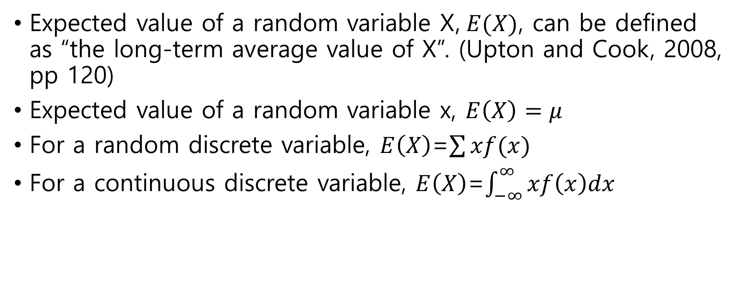
Expected value
Expected value of a random variable X,$E(X)$, can be defined as “the long-term average value of X”. (Upton and Cook, 2008, pp 120)
Expected value of a random variable x, $E\left(X\right)=μ$
For a random discrete variable, $E\left(X\right)$=$\sum{xf(x)}$
For a continuous discrete variable, $E\left(X\right)$=$\int_{−∞}^{∞}{xf\left(x\right)dx}$

Slide 19
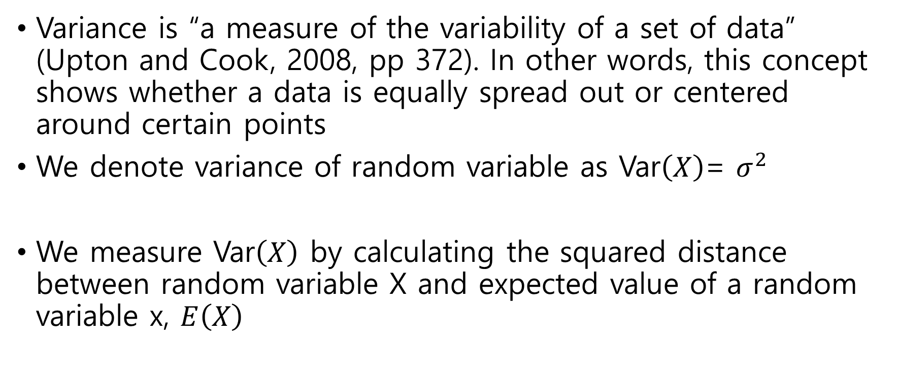
Variance
Variance is “a measure of the variability of a set of data” (Upton and Cook, 2008, pp 372). In other words, this concept shows whether a data is equally spread out or centered around certain points
We denote variance of random variable as Var$\left(X\right)$= $σ^{2}$
We measure Var$\left(X\right)$ by calculating the squared distance between random variable X and expected value of a random variable x, $E\left(X\right)$

Slide 20

Variance
Var$\left(X\right)$=$E\left[\left({X−μ)}^{2}\right]={E(X}^{2}\right)−μ^{2}$

Slide 21

Standard deviation
Standard deviation is the square root of variance
Thus, standard deviation of random variable X, sd(X)=$\sqrt{\text{Var}\left(X\right)}=σ$

Slide 22
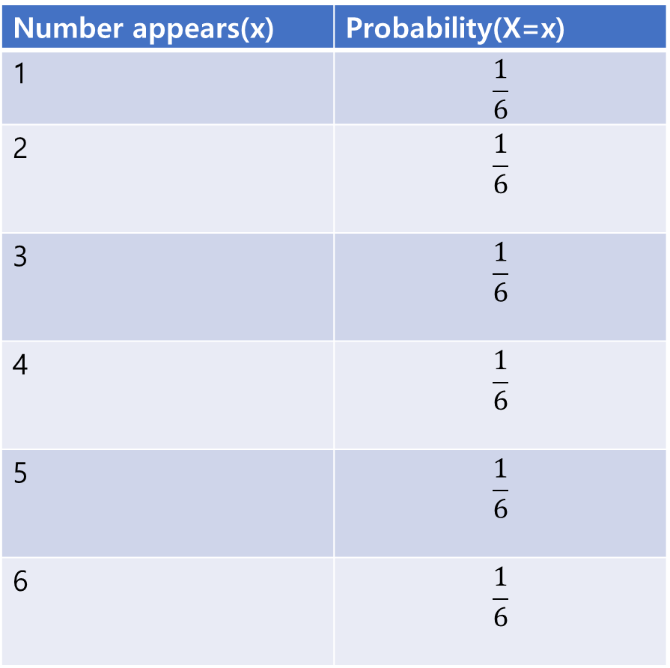
Exercise
Let’s find out what we learned
Number appears(x) | Probability(X=x)
1 | $$\frac{1}{6}$$
2 | $$\frac{1}{6}$$
3 | $$\frac{1}{6}$$
4 | $$\frac{1}{6}$$
5 | $$\frac{1}{6}$$
6 | $$\frac{1}{6}$$

Slide 23
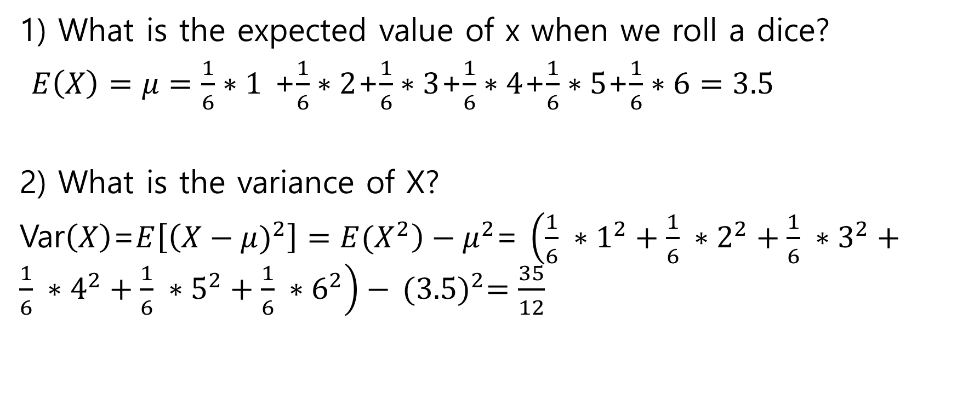
Exercise
1) What is the expected value of x when we roll a dice?
$E\left(X\right)=μ=\frac{1}{6}∗1$ +$\frac{1}{6}∗2$+$\frac{1}{6}∗3$+$\frac{1}{6}∗4$+$\frac{1}{6}∗5$+$\frac{1}{6}∗6=3.5$
2) What is the variance of X?
Var$\left(X\right)$=$E\left[\left({X−μ)}^{2}\right]={E(X}^{2}\right)−μ^{2}$= $\left(\frac{1}{6} ∗1^{2}+\frac{1}{6} ∗2^{2}+\frac{1}{6} ∗3^{2}+\frac{1}{6} ∗4^{2}+\frac{1}{6} ∗5^{2}+\frac{1}{6} ∗6^{2}\right)−$ ${(3.5)}^{2}=\frac{35}{12}$

Slide 24

Exercise
3) What is the standard deviation of X?
sd(X)=$\sqrt{\text{Var}\left(X\right)}=σ=$ $\sqrt{\frac{35}{12}}$

Slide 25
Why Probability?
We are studying political phenomena but why do we study probability? Is this useful?
As individuals who are interested in political phenomena, we are interested in political behaviors of the entire population (for instance, the voting behaviors of all people living in the earth)
However, it is considerably difficult to collect all the information due to time and financial constraints

Slide 26
Why Probability?
Instead, we take ‘sample’ of certain populations
From the sample’s statistical information, we infer the traits of ‘population’
That is the reason we need knowledge about ‘probability.’

Slide 27
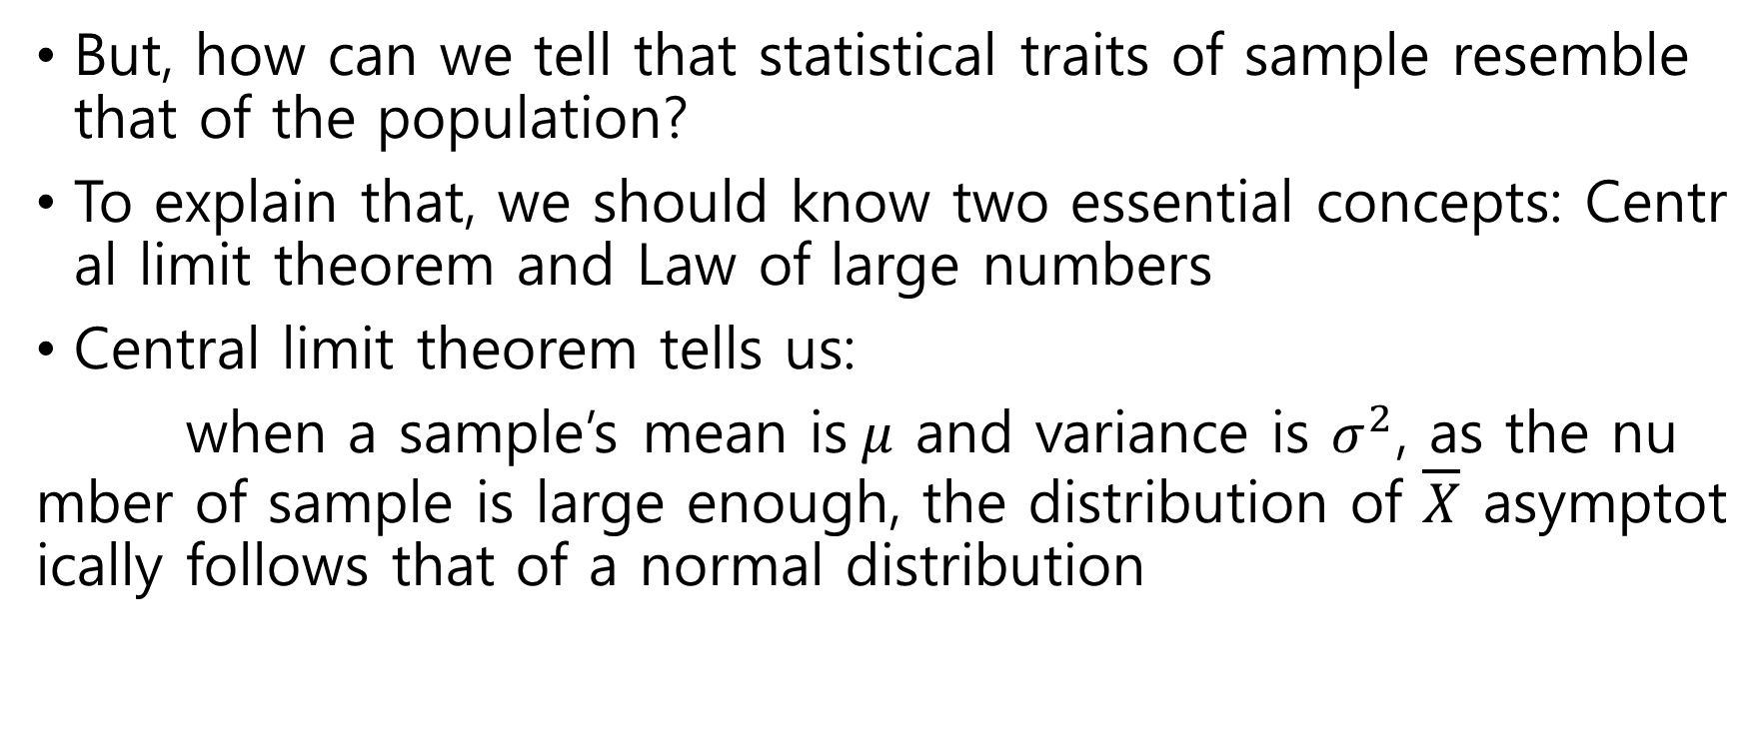
Why Probability?
But, how can we tell that statistical traits of sample resemble that of the population?
To explain that, we should know two essential concepts: Central limit theorem and Law of large numbers
Central limit theorem tells us:
when a sample’s mean is$μ$ and variance is $σ^{2}$, as the number of sample is large enough, the distribution of $\overline{X}$ asymptotically follows that of a normal distribution

Slide 28

Why Probability?
Law of large numbers tells us:
when a sample’s mean is$μ$ and variance is $σ^{2}$, as the number of sample is large enough, the mean of population $\overline{X}$ converges to the mean of sample which is$μ$

Slide 29
Conclusion
In the series of slides, we learned about distribution, expected value, variance, and standard deviation of data
Building on these concepts, we should also learn other concepts such as p-value, confidence interval, and hypothesis testing to tell more about statistical traits of data
However, that is too much information for this section and those concepts will be covered from other classes

Slide 30
Thank You!

